Slide 1
SMS/800 Template Feature
There are 11 main screens that are part of this Feature.
TAD – Template Administrative Data
CPR – Call Processing
LAD – Label Definitions
TEC – Template Selection
PAD – Pointer Administrative Data
REC – Record Selection
Convert CAD to PAD
Convert PAD to CAD
MCP (Automation)
TRL – Template Record List
TAL (Template Allocation Limit)
SMS/800 ® is a registered trademark of SMS/800, Inc.
Notes:
(Click)
SMS/800 is pleased to announce the new Template Feature. There are 10 main screens that are part of this Feature.
The TAD
(Click) CPR
(Click) LAD
(Click) PAD
(Click) REC
(Click) CONVERT CAD TO PAD
(Click) CONVERT PAD TO CAD
(Click) MCP
(Click) TRL
(Click) And the TAL screens
(Click) I will review each of these screens in following viewgraphs.
(Click)

Slide 2
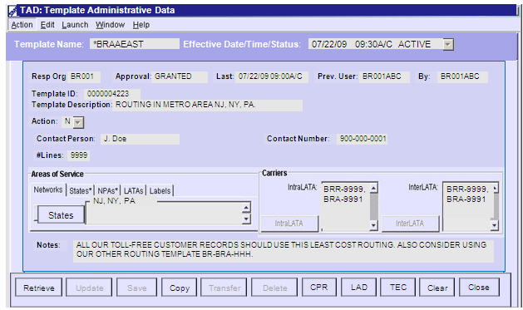
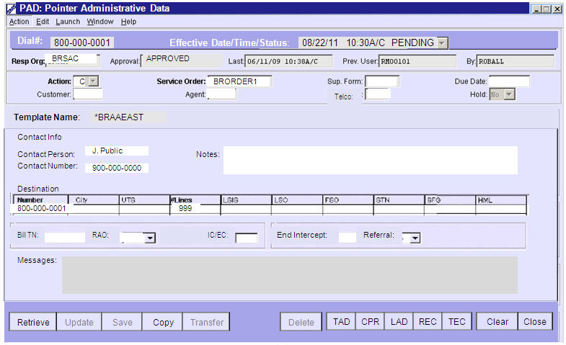
Template Feature Example
User first builds a Template TAD, Then a Pointer PAD
*BRAAEAST
Build a Template (TAD)
Build a PAD - Pointer
Notes:
(Click)
To take advantage of the Template feature, A user first builds a Template TAD. For Example: *BRAAEAST
(Click)
Included on the TAD is the AOS
(Click)
The Carriers
(Click)
The buttons for CPR
(Click)
LAD Labels
(Click)
Then the user creates a PAD for a new reserved number. For
example: 800-000-001
(Click) (Click)
In the PAD, the user types the name of the Template,
“*BRAAEAST” in the “Template Name” field.
(Click) (Click)
Now the PAD points to the Template
(Click) (Click)
All Routing for this 800 number will be done according to the template data of *BRAAEAST.
(Click)
Many PADs can point to the same TAD.
(Click)

Slide 3
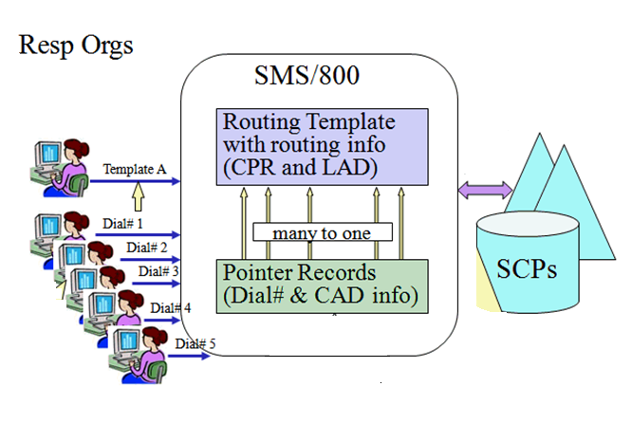
Template/Pointer Example
Five Step process: 1-Create a TAD, 2-TAD goes Active, 3-Create multiple PADs, 4-PADs go Active, 5-Future change only single TAD
Step 1:
Resp Org creates a Routing Template.
Step 2:
Routing Template Goes ACTIVE at the SCPs.
Step 3:
Resp Org creates multiple Pointer Records that point to the Template for Routing.
Step 4:
Each Pointer Record goes Active at the SCPs.
Step 5:
If routing needs to change, only the single Routing Template needs to be updated.
Notes:
Step 1… The Resp Org first creates a Routing Template.
(Click)
Step 2… The Routing Template goes Active at the SCPs.
(Click)
Step 3… The Resp Org creates multiple Pointer Records that have the same routing.
(Click)
Step 4… Each Pointer Record goes Active at the SCP.
(Click)
Step 5… If routing needs to change, the Resp Org needs only to change the single Template.
(Click)

Slide 4
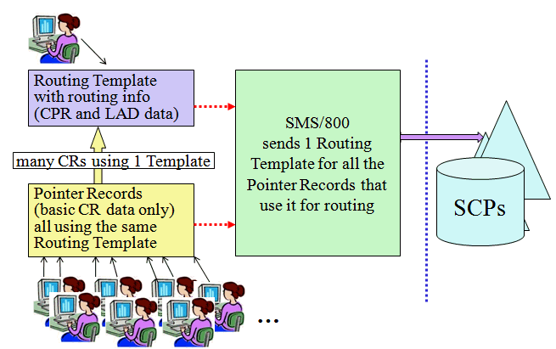
Template Benefits
Resp Org saves time and resources because only 1 template needs changing which automatically updates all Pointers. SCPs and SMS/800 saves space as only 1 large CPR and LAD is loaded.
Notes:
The main benefits of Templates are two fold:
(Click)
(Resp Org Benefit) The ability for a Resp Org to build many Simple Pointer records that point to a single Template. Later, if a change of carrier or other routing change is needed, only one record needs to be updated, Saving Time and employee resources.
(Click) (Click)
(SCP Benefit) Templates will reduce the amount of space needed at the SCP to store Customer Records.
(Click)
The CPR and LAD is the largest part of a Customer Record. 1000 simple Pointers could use a single Template.
(Click)

Slide 5
TAD (Template Admin. Data)
The Template TAD contains the Area of Service, the Carriers and the buttons for the CPR, LAD and TEC.
9901
9902
9903
9901
9902
9903
Notes:
Let us review each screen individually. Here is a TAD screen…
(Click)
This is the screen where we build a new Template TAD. Displayed is the Template named, “BRAAEAST”.
(Click)
The TAD screen defines: the Area of Service i.e. NJ, NY, PA
(Click)
Carriers i.e. 9901, 9902, 9903
(Click)
the buttons to access the CPR(Complex Routing)
(Click)
and LAD (Label Definitions)
(Click)
or the TEC

Slide 6
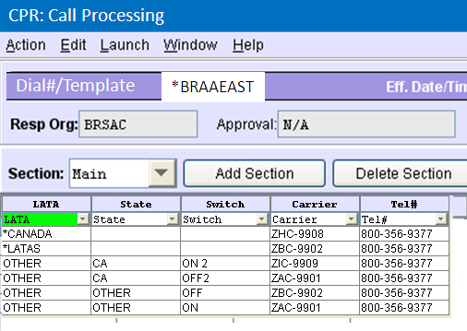
CPR: Call Processing
The CPR for the Template has 1 unique change. The Tel# field can only contain #Dial. Meaning that the ring to for this row is listed on the Pointer (PAD).
#Dial
#Dial
#Dial
#Dial
#Dial
Notes:
(Click)
This is an example of the CPR for the Template TAD “*BRAAEAST” (Click) CPR Template Rows(Branches) can only terminate to the Dial Number Turnaround in a TAD (a POTS is not allowed).
(Click)
Any Pointer record PAD that points to this TAD will use this CPR routing and the LAD labels shown on the next slide
(Click)

Slide 7
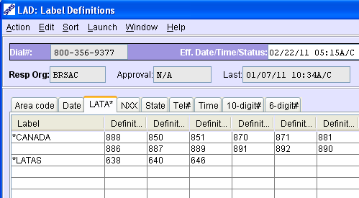
LAD: Label Definitions
The LAD for the Template is exactly the same as for a regular Customer Record except the Name field.
Notes:
(Click)
This is an example of the LAD for the Template TAD “*BRAAEAST”.
(Click)
Any Pointer record PAD that points to this TAD will use these
LAD Labels for the CPR
(Click)

Slide 8
PAD (Pointer)
The Pointer (PAD) simply holds the Toll Free number and the Template name where the complex routing is found.
PAD - Pointer
Notes:
(Click) This is a Pointer Record (PAD), for the Toll Free number
800-000-0001
(Click) This PAD points to the Template “*BRAAEAST” for routing
(Click) Pointer records point to the TAD
(Click) the CPR of the TAD
(Click) and the LAD of the TAD
(Click) of the Template to get their routing.
(Click) The REC can be used to Convert a PAD to a CAD and list all records for this specific PAD (Pointer)
(Click) the TEC can be used to list all records for the specific TAD (Template)
(Click)

Slide 9
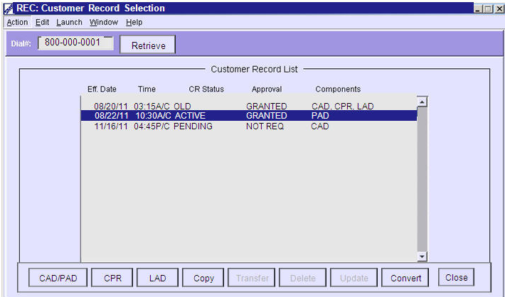
REC (Record Selection List)
The REC screen (CR Selection List) displays a list of all the CRs that have been built for this Toll Free #. The Unique addition to this screen is the Convert button.
Notes:
The REC screen (CR Selection List)…
(Click)
displays a list of all the CRs that have been built for this Toll Free #. i.e. 3 records each with a different date. 8/20/11, 8/22/11 and 11/16/11
(Click)
Included for each record is the Eff Date, time, CR Status, Carrier approval and components.
(Click)
The Convert button on the REC takes the user to the Convert CAD to PAD or Convert PAD to CAD depending from which screen the REC button is pressed: CAD or PAD.
(Click)

Slide 10
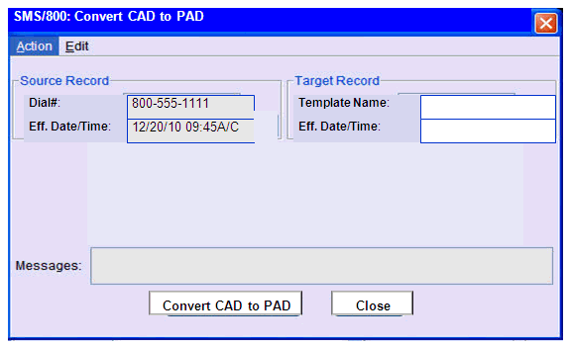
Convert CAD to PAD
The Convert CAD to PAD screen allows the conversion of CAD to a PAD
*BRAAEAST
12/12/10 5:30 a/c
Notes:
(Click)
The “Convert CAD to PAD” Screen allows the user to
Change(Convert) a regular “Source Record” CAD
(Click)
to a Pointer record (PAD)
(Click)
The Target record fields contain the Template information.
(Click)
The “Convert CAD to PAD” button executes the conversion.
(Click)
The CONVERT option button is listed in the bottom row of the REC for the CAD

Slide 11
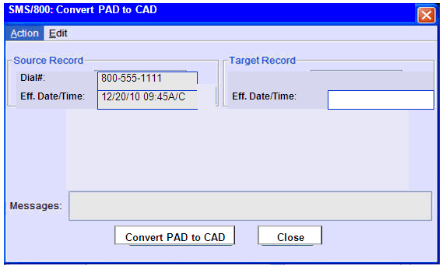
Convert PAD to CAD
The Convert PAD to CAD option is available when the Convert button is pressed from the REC when a PAD is highlighted in the list.
12/12/10 5:30 a/c
Notes:
(Click)
You can also convert a “Source Record” Pointer Record (PAD)
(Click)
back to a regular CAD
(Click)
The CAD will then stand by itself, not needing a Template.
(Click)
The CONVERT option button is listed in the bottom row of the REC for the PAD

Slide 12
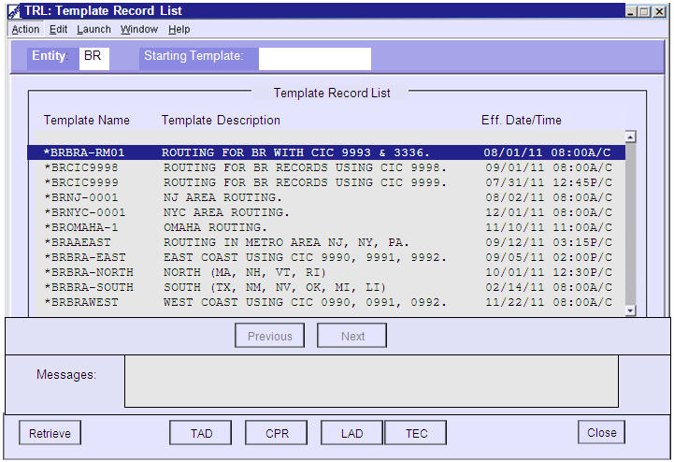
TRL (Template Record List)
The TRL screen displays a list of all the Templates that have been built by a
specific Entity.
Notes:
The TRL screen (Template Record List)…
(Click)
displays a list of all the Templates that have been built by a
specific Entity. This example is for the entity “BR”.
(Click)
Included is the Template Name
(Click)
The Description
(Click)
and the Eff. Date/Time.
(Click) (Click)

Slide 13
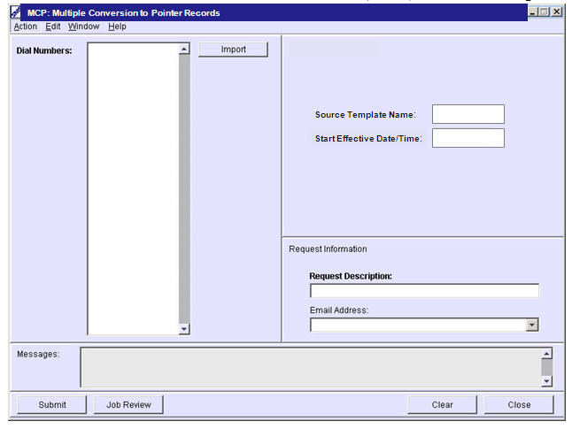
MCP (Automation Pointer)
800-234-xxxx
800-234-yyyy
800-234-zzzz
Etc.
*BRAAEAST
12/12/10 5:30 a/c
The MCP (Automation) screen allows a conversion of up to 5000 numbers in a single request.
Convert to PAD 1
Notes:
(Click)
The MCP screen is an Automation screen…
(Click)
that allows the user to convert up to 499 regular CAD customer
records…
(Click)
to Pointer Records (PAD) . Numbers can be Copied/pasted, typed or imported from a TXT file into the Dial Number field.
(Click)
Type in the Template name and Eff. Date/time for the conversion (Click) Type in the request description and Submit
(Click)

Slide 14
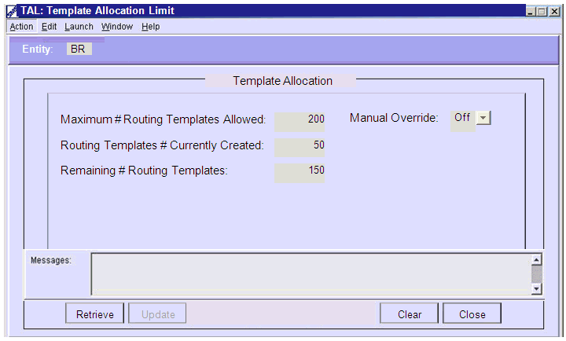
TAL (Template Allocation Limit)
The TAL screen displays the limits for the templates built for a
specific Entity.
Notes:
(Click)
The TAL (Template Allocation Limit) screen shows: The maximum
number of Templates that a Resp Org Entity
(Click)
is allowed to build
(Click)
The current number already created
(Click)
And the remaining number that can be created before reaching
the limit
(Click) (Click)

Slide 15
Template Summary
TAD – Template Administrative Data
CPR – Call Processing
LAD – Label Definitions
TEC – Template Selection
PAD – Pointer Administrative Data
REC – Record Selection
Convert CAD to PAD
Convert PAD to CAD
MCP (Automation)
TRL – Template Record List
TAL (Template Allocation Limit)
Notes:
In Summary the 10 Major screens of the Template Feature include:
(Click)
1.The TAD (Template Administrative Data – A screen like the CAD but
used for Templates)
(Click)
2. CPR (Call Processing Record – Exactly like the Customer Record CPR
except attached to the TAD)
(Click)
3. LAD (Label Definitions) Shorthand way of setting up routing.
(Click)
4. PAD (Pointer Record – The unique Toll Free number that points to the
Template TAD to get its routing instructions)
(Click)
5. REC (Record Selection)
(Click)
6. CONVERT TO PAD – Converts a list of regular CAD records to PAD
records.
(Click)
CONVERT TO CAD – Converts a list of PAD records back to regular CAD records.
(Click)
MCP – Automation screen allowing a mass change of up to 499 normal numbers to Pointer records.
(Click)
9. TRL (Template Record List – Lists all the Templates (TAD) for a given
Entity.
(Click)
10. TAL – Allows a user to view Template Limits for their Entity.
(Click)

Slide 16
TAD Review
The New Template Feature includes 11 screens. The Template Feature allows a Resp Org to create 0ne Template that contains the TAD with AOS, Carriers, and the attached CPR and LAD for any complex routing.
All Identical (CAD, CPR, LAD) customer records for a Resp Org could potentially be converted to PAD (Pointer) records pointing to the single Template for the complex routing.
Written Exercise TAD #6
Hands-On Exercises TAD (6A–6C)
Notes:
Complete the Written and Hands- On Exercises for the LAD Module.

